Slide 1
SMOKE DETECTOR:
IMPLEMENTATION AND COMPARISON OF MACHINE LEARNING METHODS FOR BINARY CLASSIFICATION
Lorenzo Busellato – VR472249
Daniele Nicoletti - VR472590
Machine Learning and Artificial Intelligence
Master’s degree in Computer Engineering for Robotics and Smart Industry – a.y. 2022/2023

Slide 2
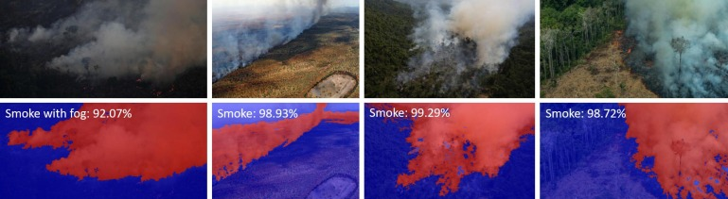
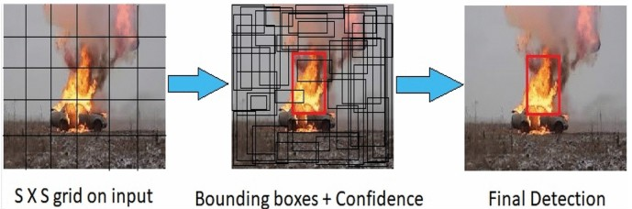
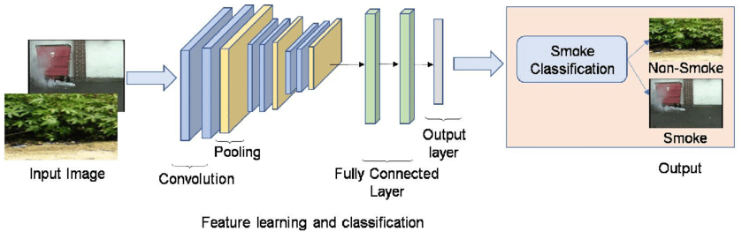
INTRODUCTION
Smoke segmentation
Smoke localization
STATE-OF-THE-ART
Lack of publicly available, extensive datasets
Image-based Deep Learning approaches
Smoke classification

Slide 3
OBJECTIVES
Obtain a comprehensive comparison of classical machine learning methods for binary classification
Compare the effect of different feature selection methods
Determine the best feature selection-model-hyperparameters combination in terms of accuracy and False Alarm Rate
WORKFLOW:
Classifier:
Hyperparameter tuning
Training with best parameters
Testing
Dataset preparation:
Class balancing, scaling
Best model
Feature selection

Slide 4
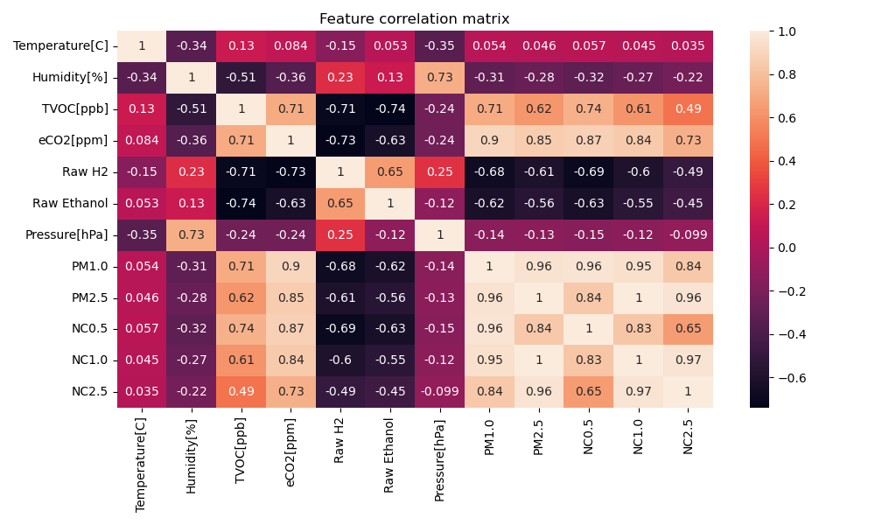
DATASET
Features:
  Temperature [C]
  Humidity [%]
  TVOC [ppb]
  CO2 [ppm]
  H2 [%]
  Ethanol [%]
  Pressure [hPa]
  PM1.0, PM2.5 [density]
  NC0.5, NC1.0, NC2.5 [number of particles]
Dataset preparation:
  Class balancing
  Scaling: remove μ, scale to unit σ²
  80/20 train/test split
Ground truth:
  Fire alarm [binary]

Slide 5
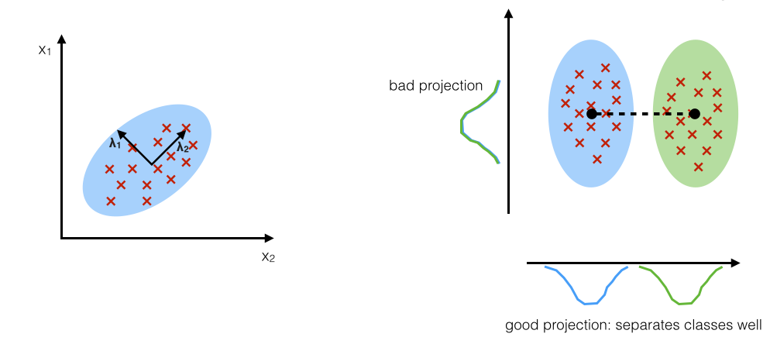
FEATURE SELECTION
PCA
LDA
Components are the directions of maximum variance
Component(s) are the directions of maximum class separation

Slide 6
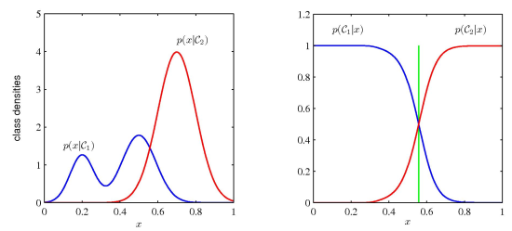
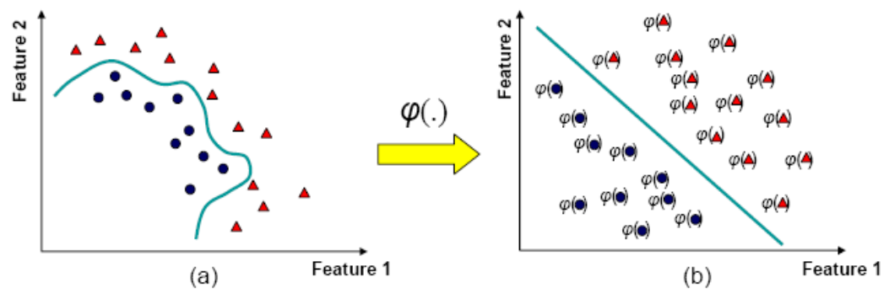
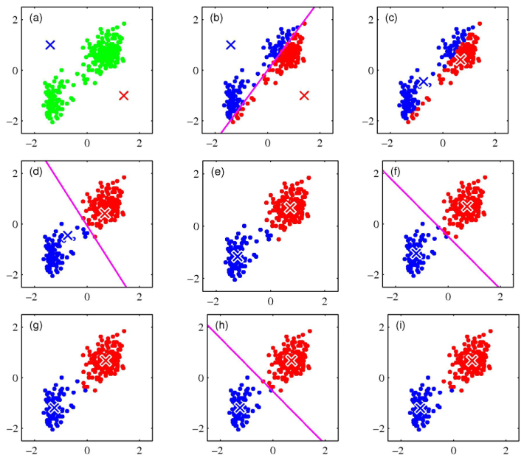
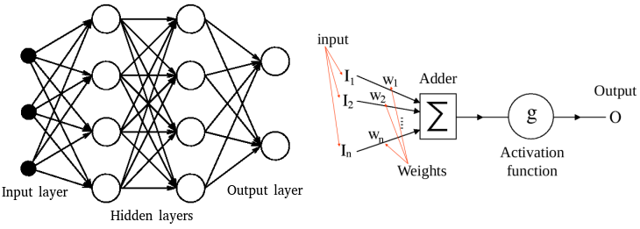
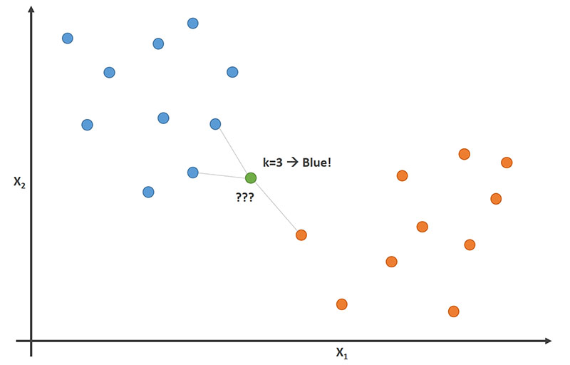
CLASSIFIERS
SUPERVISED
UNSUPERVISED
Support Vector Machines
Naive Bayes
K-Means clustering
Multi-Layer Perceptron
K-Nearest Neighbors

Slide 7
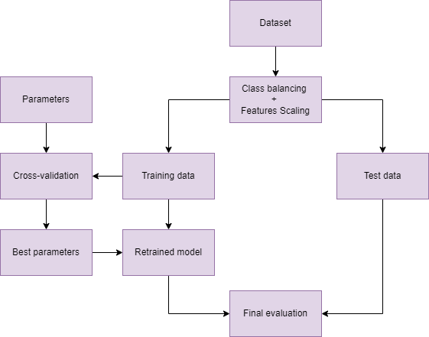
WORKFLOW

Slide 8
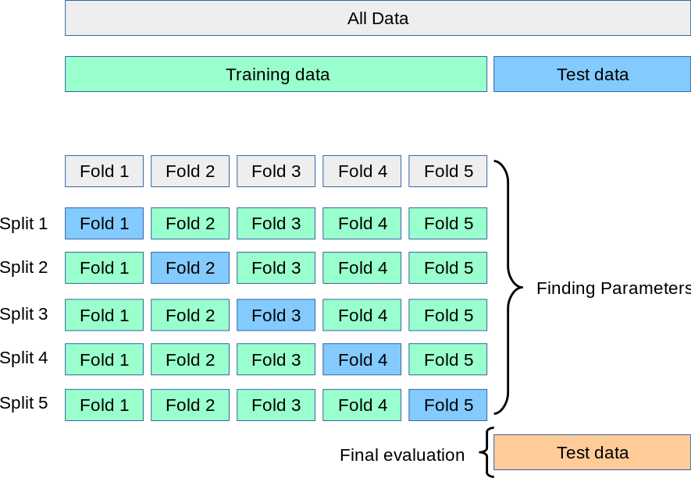
HYPERPARAMETER TUNING
Cross-validation
List of parameter combinations
“Best” parameters
e.g. for KNN:
  K: np.linspace(1,300,50)
  Weights: uniform, distance
  Metric: cityblock, euclidean,
  minkowski

Slide 9
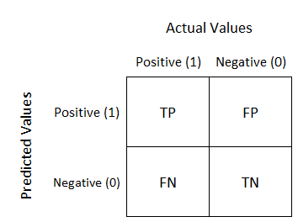
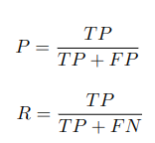



EVALUATION METRICS
CONFUSION MATRIX
HYPERPARAMETER TUNING
precision
F1-score
recall
MODEL COMPARISON
accuracy
False Alarm Rate

Slide 10
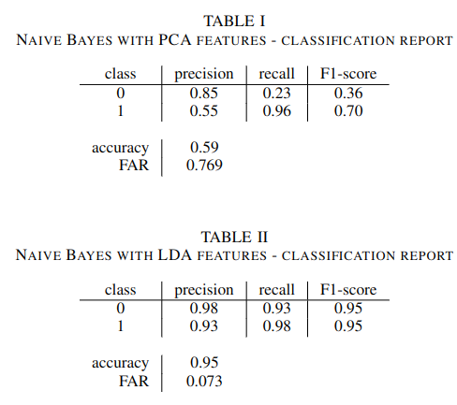
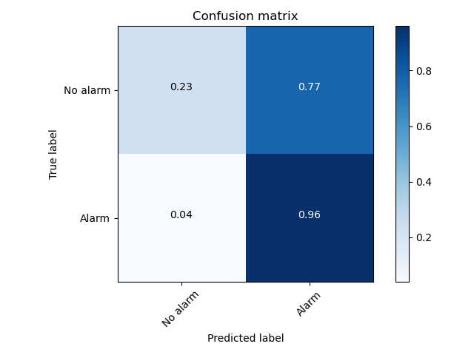
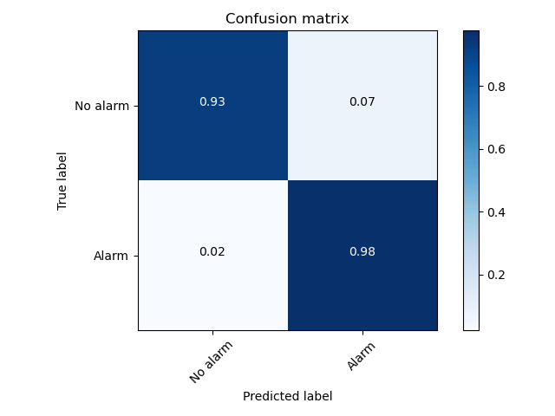
NAIVE BAYES – TESTING RESULTS
PCA
LDA

Slide 11
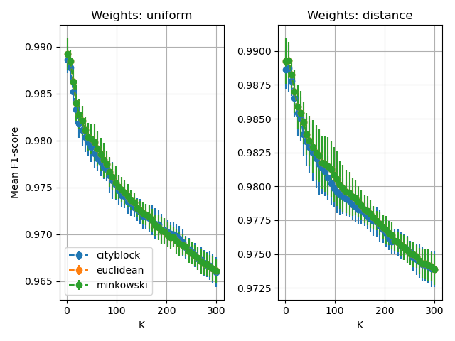
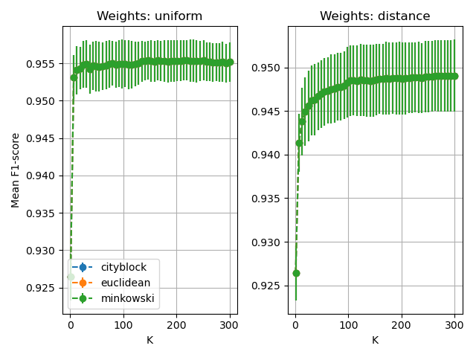
K-NEAREST NEIGHBORS – HYPERPARAMETER TUNING
PCA
LDA
Parameter space:
K: np.linspace(1,300,50)
Weights: uniform, distance
Metric: cityblock, euclidean,
  minkowski
Best model: K=7, euclidean, distance
Best model: K=220, cityblock, uniform

Slide 12
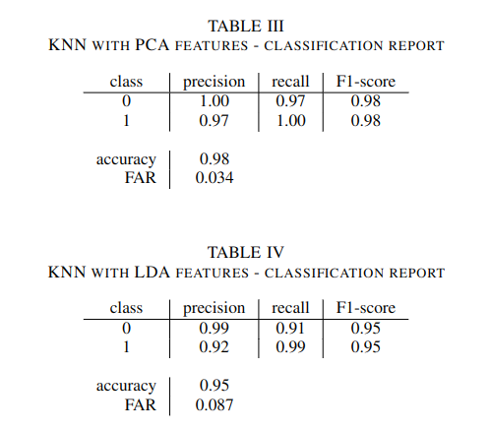


K-NEAREST NEIGHBORS – TESTING RESULTS
PCA
LDA
Best model: PCA, K=7, euclidean, distance

Slide 13
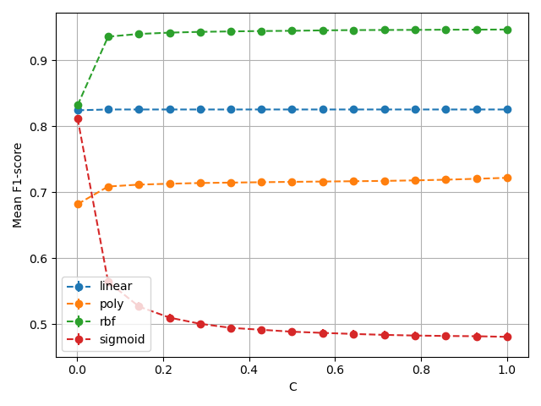
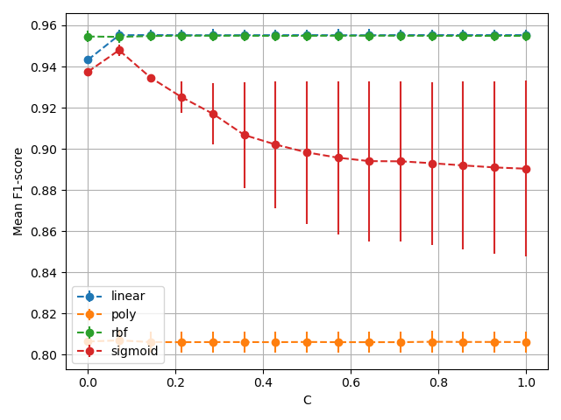
SUPPORT VECTOR MACHINE – HYPERPARAMETER TUNING
PCA
LDA
Parameter space:
C: np.linspace(0.001,1,15)
Kernel: linear, polynomial, rbf, sigmoid
Best model: C=1, rbf kernel
Best model: C=0.144, linear kernel

Slide 14
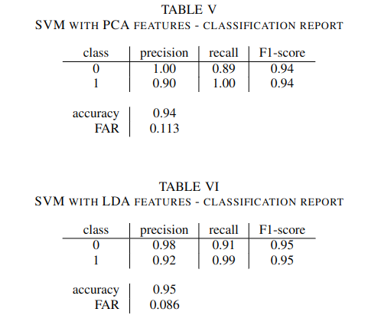
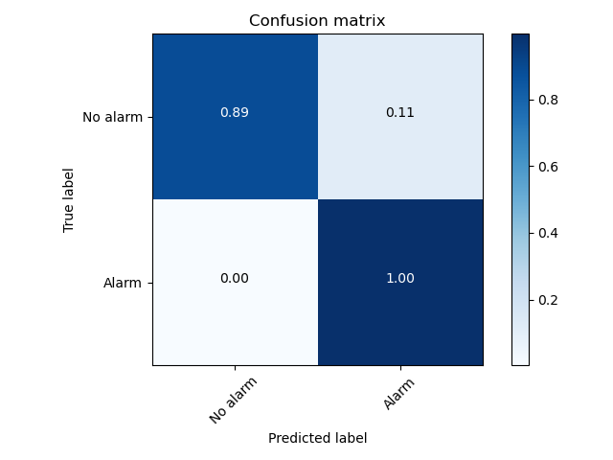

SUPPORT VECTOR MACHINE – TESTING RESULTS
PCA
LDA
Best model: LDA, C=0.144, linear kernel

Slide 15
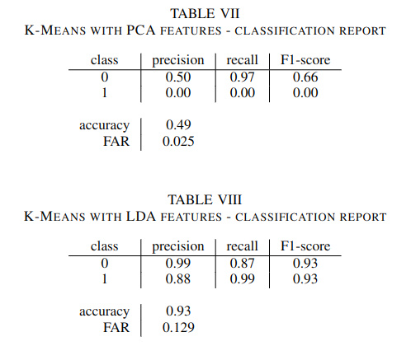
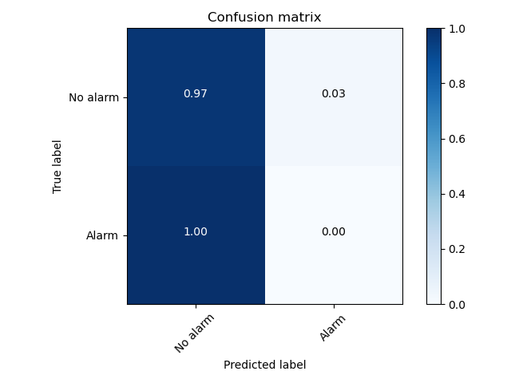

K-MEANS CLUSTERING – TESTING RESULTS
PCA
LDA

Slide 16
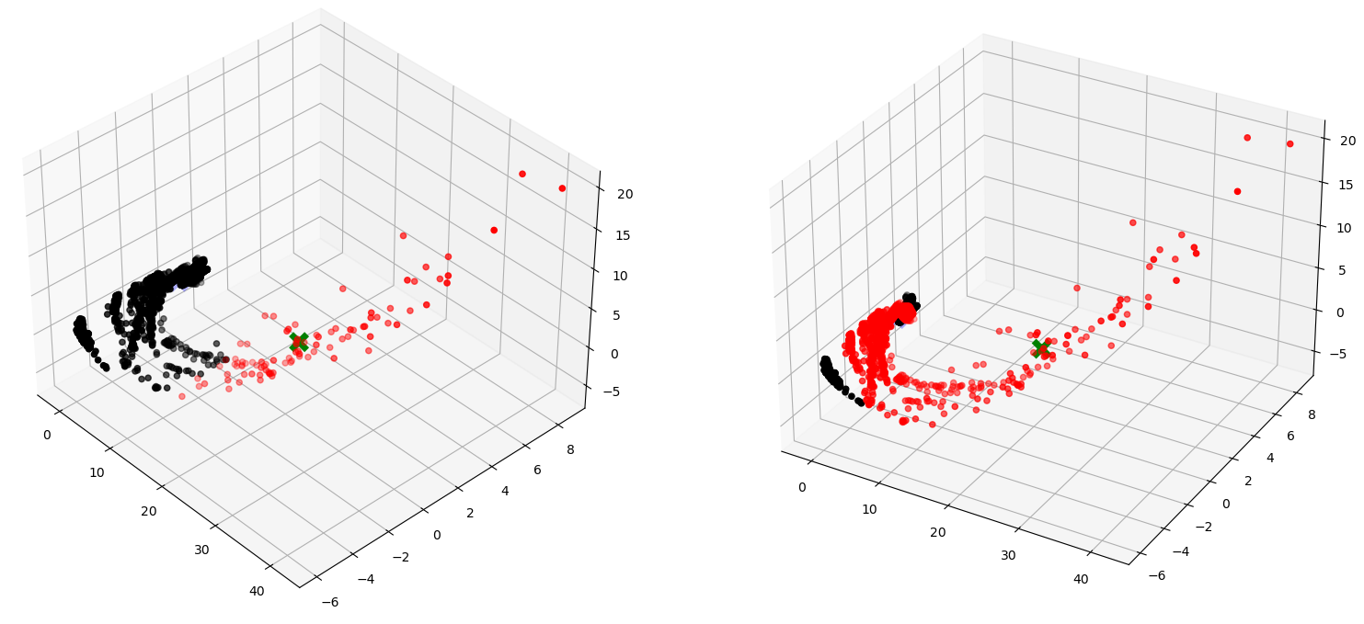
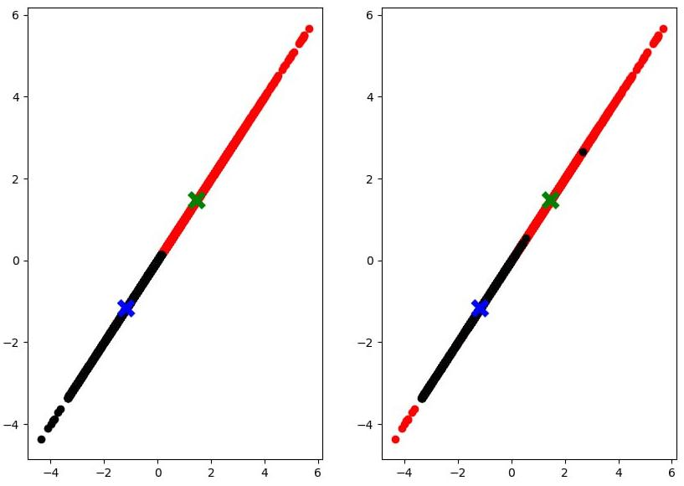
K-MEANS CLUSTERING – PCA VS LDA
PCA
LDA
clusters
ground truth
clusters
ground truth

Slide 17
MULTI-LAYER PERCEPTRON – HYPERPARAMETER TUNING
Parameter space:
η: [0.001, 0.01, 0.1, 1, 10]
Activation function: logistic, tanh, ReLU
Hidden layer sizes: (), (2), (4), (2, 2), (4, 4)

Slide 18
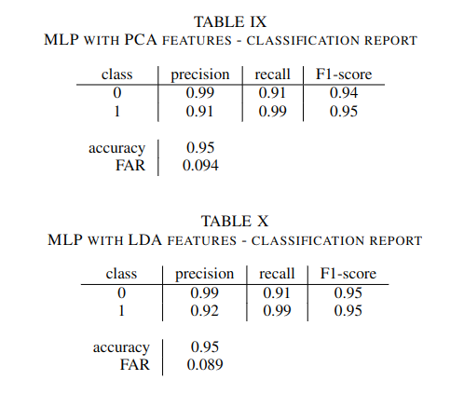

MULTI-LAYER PERCEPTRON – TESTING RESULTS
PCA
LDA
Best model: η=0.01, ReLU, hidden layers (4,4)
Best model: η=0.01, tanh, hidden layers (4)

Slide 19
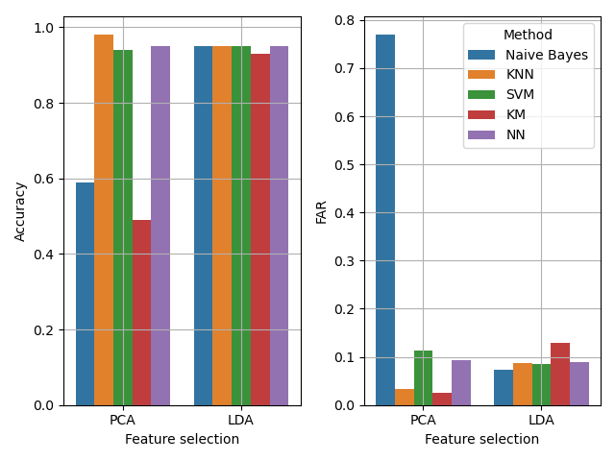
CONCLUSIONS
Best overall model: KNN w/ PCA, K=7, euclidean, distance
Accuracy: ≈98% FAR: ≈3%
LDA more consistent results than PCA
PCA better accuracy and FAR for the best model

Slide 20
THANK YOU FOR YOUR ATTENTION

